Slide 1
Chapter 3: Basic Information Theory

Slide 2
The Information Age
As early as 2003, experts estimated that humanity had accumulated a little more than 12 exabytes of data over the entire course of human history.
Modern media, such as magnetic storage, print, and film, had produced 5 exabytes in just the first two years of the 21st century.
In 2009, researchers claimed that in a single year Americans consumed more than 3 zettabytes of information.
As of 2013, the World Wide Web is estimated to include 4 zettabytes, or 4000 exabytes, of data.

Slide 3
The Information Age
Kilobyte = 1000 bytes
Megabyte = 1,000,000 bytes
Gigabyte = 1,000,000,000 bytes
Terabyte = 1,000,000,000,000 bytes
Petabyte = 1,000,000,000,000,000 bytes
Zettabyte = 1,000,000,000,000,000,000 bytes

Slide 4
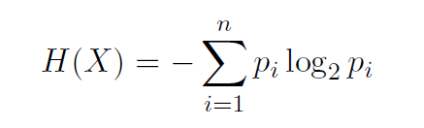
Information Entropy
In information theory, entropy is the amount of information in a given message.
It is sometimes described as the number of bits required to communicate information.
Another way to describe information entropy, used in many texts, is the measure of uncertainty in a message.

Slide 5
Information Entropy
In addition to information entropy are a few closely related concepts:
Joint entropy: This is the entropy of two variables or two messages. If the two messages are truly independent, their joint entropy is just the sum of the two entropies.
Conditional entropy: If the two variables are not independent, but rather variable Y depends on variable X, then instead of joint entropy you have conditional entropy.
Differential entropy: This is a more complex topic and involves extending Shannon’s concept of entropy to cover continuous random variables, rather than discrete random variables.

Slide 6
Confusion and Diffusion
The concept of confusion, as relates to cryptography, was outlined in Claude Shannon’s 1949 paper “Communication Theory of Secrecy Systems.” In general, this concept attempts to make the relationship between the statistical frequencies of the cipher text and the actual key as complex as possible.
Diffusion literally means having changes to one character in the plain text affect multiple characters in the cipher text.
Avalanche means that a small change yields large effects in the output, like an avalanche. This is Horst Fiestel’s variation on Claude Shannon’s concept of diffusion.

Slide 7
Hamming Distance and Weight
The Hamming distance is the number of characters (or bits) that are different between two strings. This can be expressed mathematically as
  h(x, y)
The concept of Hamming weight is closely related to Hamming distance. It compares the string to a string of all 0’s. Put more simply, it is how many 1’s are in the binary representation of a message. Some sources call this the population count or pop count.

Slide 8
Kerkhoffs’s Principle/Shannon’s Maxim
Auguste Kerckhoffs first articulated this in the 1800s, stating that the security of a cipher depends only on the secrecy of the key, not the secrecy of the algorithm.
Claude Shannon rephrased this, stating, “One ought to design systems under the assumption that the enemy will ultimately gain full familiarity with them.” This is referred to as Shannon’s maxim and states essentially the same thing Kerckhoffs’s principle.

Slide 9
Easttom’s Corollary
I would add to Kerchoffs’s principle/Shannon’s maxim something I will humbly call Easttom’s corollary:
“You should be very wary of any cryptographic algorithm that has not been published and thoroughly reviewed. Only after extensive peer review should you consider the use of any cryptographic algorithm.”

Slide 10
Mathematical Theories
Theories in math flow from axioms. An axiom is a single fact that is assumed to be true without proof.
I think it should be obvious to all readers that one must have only the most basic facts taken on an a priori basis as axioms.

Slide 11
Binary Math
Number in base ten (decimal) | Number in base two (binary)
0 | 0
1 | 1
2 | 10
3 | 11
4 | 100
5 | 101
6 | 110
7 | 111
8 | 1000

Slide 12
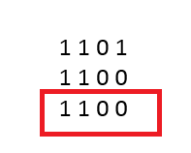
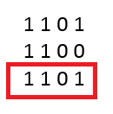
Binary AND and OR
Binary AND
Binary OR

Slide 13
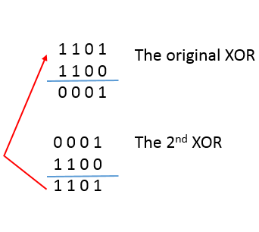
Binary XOR

